Slide 1
SAP BTP Extension Suite Training
Day 9
Anubhav Oberoy
www.AnubhavTrainings.com
Follow excellence with sheer passion

Slide 2


DISCLAIMER
The training content and delivery of this presentation is confidential, and cannot be recorded, or copied and distributed to any third party, without the written consent of Anubhav Trainings

Slide 3
Agenda – Day 9
01
Generic Handler
02
Fiori App
03
Annotations

Slide 4


Generic Handlers in CAP
The CAPM framework generates most of the code to perform CURDQ operations on the entity. It does not know what validations to perform on our business data. As a developer, when we want to attach a pre-check (validations) / post-check (post processing code) on an entity operation, we can use generic handlers. All these operations are performed SYNCHRONOUSLY.
At times we want to
Take full control of our implementation
We want to add some validation before data is inserted or updated
We want to change data before insert/update
Read some extra information while GET calls
Fiori app
odata
cap
Generic handlers
database
before
on
after

Slide 5

Hands on: Generic Handlers

Slide 7
Syntax
this.when(‘WHICH’, what, () => {
code.
})
when – before, after, on
Which – CREATE, UPDATE, DELETE, READ
What – Entity (Employee, Pos, …)

Slide 8
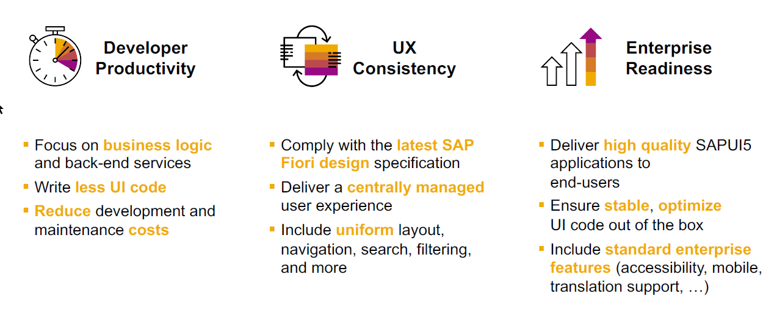
SAP Fiori elements boosts SAP Fiori development efficiency

Slide 9
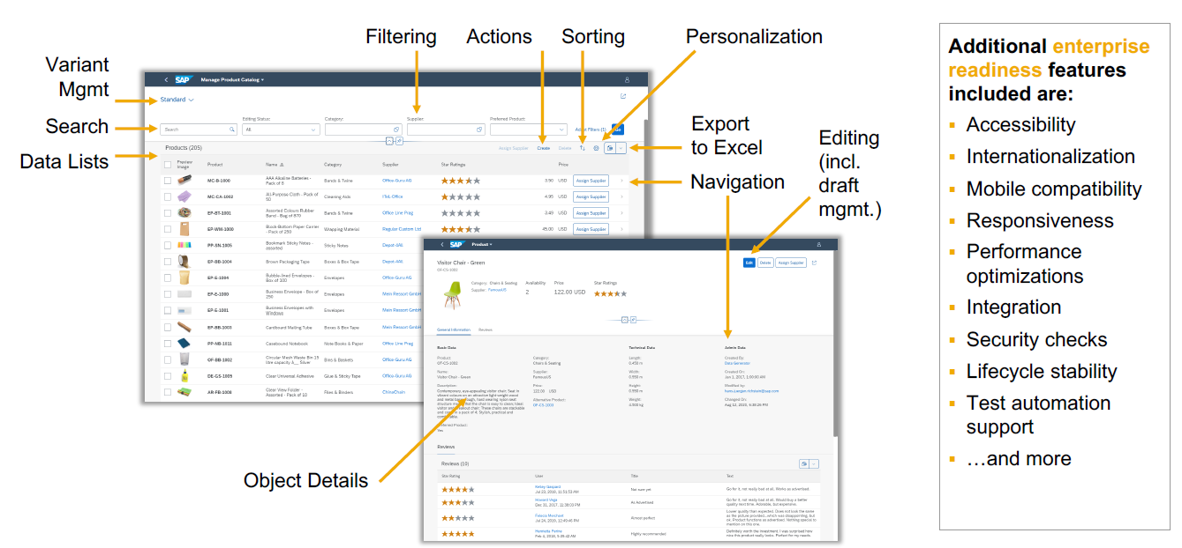
SAP Fiori elements provides enterprise-ready apps out of the box

Slide 10
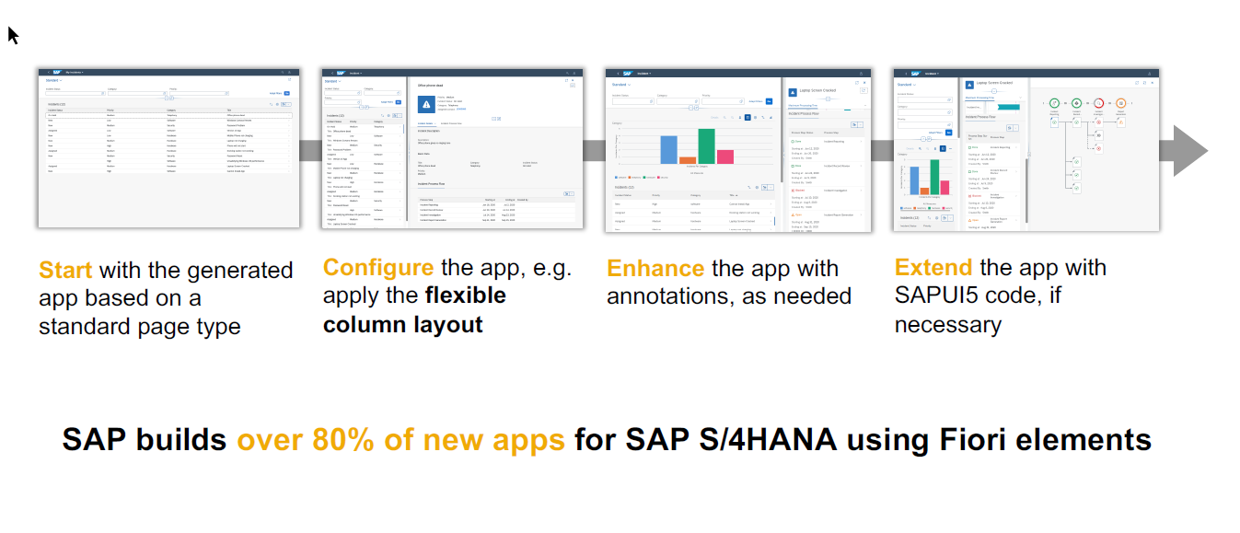
SAP Fiori elements application architecture provides flexibility

Slide 11
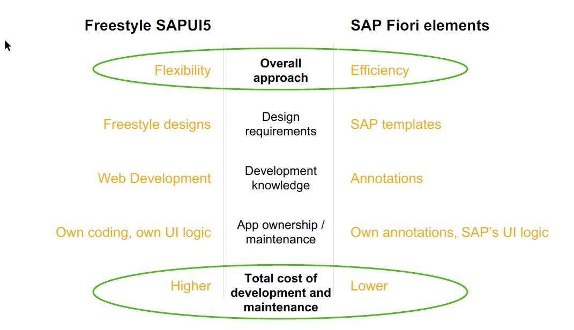
SAP Fiori elements prioritizes efficiency over flexibility

Slide 12

Hands on : Fiori App

Slide 13






























Slide 14





















namespace

Slide 15






































Slide 17
Annotations
@UI.SelectionField – selection fields
@UI.HeaderInfo – for title of the table
@UI.LineItem – Create columns of the table

Slide 18
Create Fiori App using Annotation
Exercise:
https://github.com/soyuztechnologies/SAP_BTP_Training_CLD200/blob/master/Day%203/03%20application/03application/app/purchaseorderapp/annotations.cds

Slide 19
Association v.s Composition
Association – a relationship between entities which is a lose coupling. Both objects should exist together. However, they can work independently. Airplane and passenger.
Composition – a relationship between entities which is a tight coupling. Both objects must exist together. They cannot function independently. Airplane and wings.
Purchase Order Header
composition
Purchase order Items

Slide 20

Hands on: Create & F4 Enablement for app
Solution: https://github.com/soyuztechnologies/SAP_BTP_Training_CLD200/tree/master/Day%204/capm%20draft%20and%20value%20helps

Slide 21
Hands on : Fiori App

Slide 22
Create Fiori App using Annotation
Exercise:
https://github.com/soyuztechnologies/SAP_BTP_Training_CLD200/blob/master/Day%203/03%20application/03application/app/purchaseorderapp/annotations.cds

Slide 23
Association v.s Composition
Association – a relationship between entities which is a lose coupling. Both objects should exist together. However, they can work independently. Airplane and passenger.
Composition – a relationship between entities which is a tight coupling. Both objects must exist together. They cannot function independently. Airplane and wings.
Purchase Order Header
composition
Purchase order Items

Slide 24


























Slide 25

































Slide 26
Hands on: Create & F4 Enablement for app
Solution: https://github.com/soyuztechnologies/SAP_BTP_Training_CLD200/tree/master/Day%204/capm%20draft%20and%20value%20helps

Slide 30

What We Did
Let’s Summarize

Slide 31

www.anubhavtrainings.com
Thank You
End of Day 4

Slide 32


We’re committed to empower you to be
#FutureReady
through powerful training solutions.
We build the workforce of the future.
250+
Corporate Clients
50,000+
Learners Trained
25000+
Learners Placed
FREE WEBINARS
Sign up for free webinars with industry experts every fortnight!
Enroll Now!
Contact us today!
https://anubhavtrainings.com

Slide 33
Agenda – Day 4
01
04
Introduction to HANA Cloud
Identity Provider
02
05
Connecting to HANA Cloud Instance
JWT Token and Application Router
03
06
Authentication v/s Authorization
Deploy App to CF

